Slide 1
Creating a .NET MAUI App

Slide 2
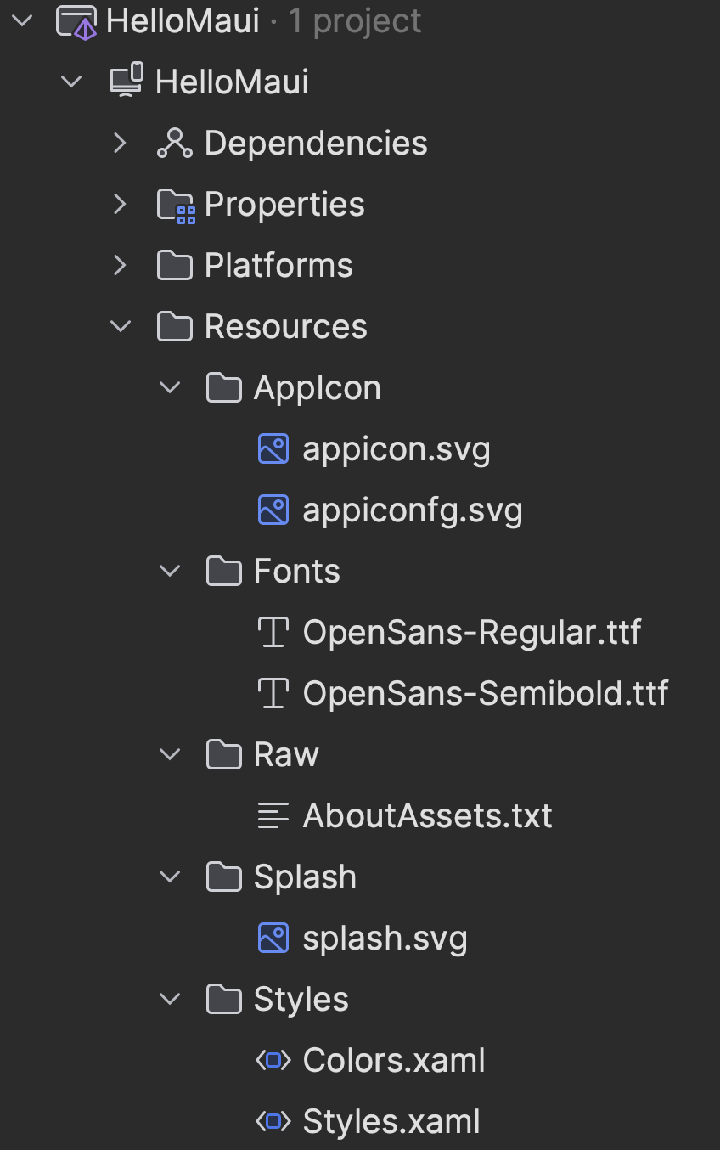
Creating UI Resources
AppIcon
appicon.svg
App Icon background image
appiconfig.svg
App Icon foreground image
Fonts
Add Custom Fonts
Supports OTF and TTF
Raw
Add Embedded Resources
E.g. Images, Binaries, etc
Splash
splash.svg
Splash Screen Image
Styles
Colors.xaml
Custom Colors
ResourceDictionary
Styles.xaml
Custom Styles
ResourceDictionary

Slide 3
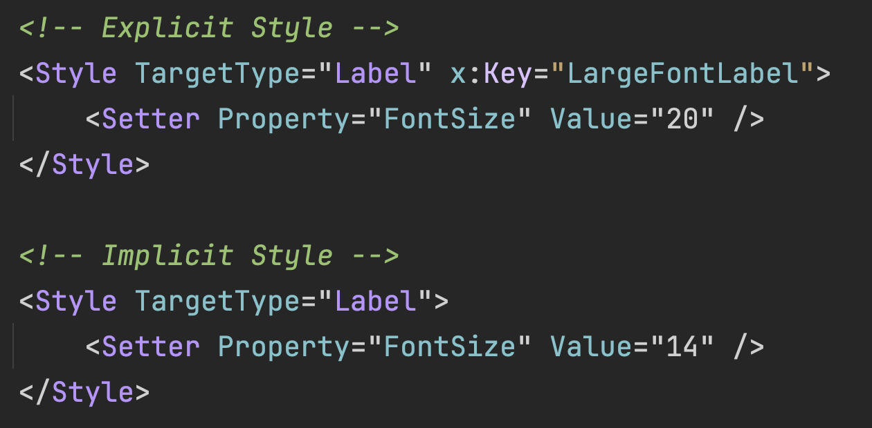
Creating UI Styles
Styles apply Properties to Multiple Elements
Implicit Style
Applies a style implicitly to every TargetType
Explicit Style
Applies a style only when Key is referenced

Slide 4
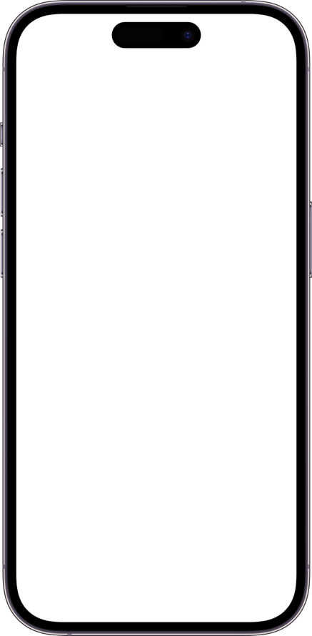
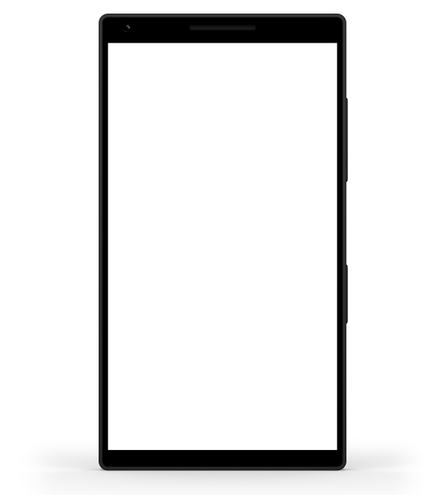
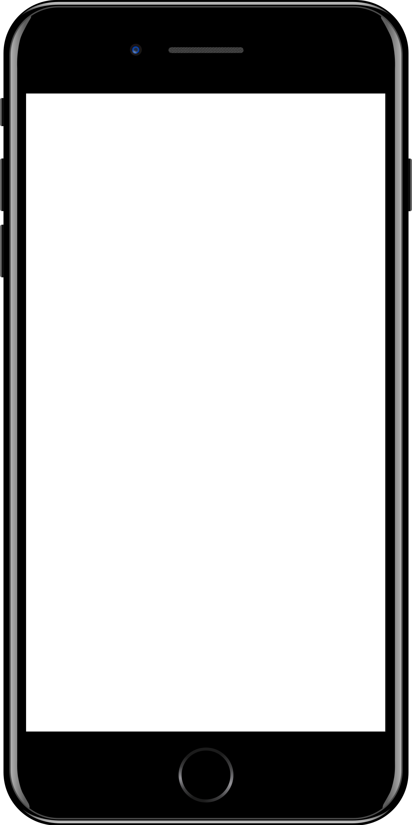
Sample mobile app slide
iPhone 7/8
iPhone 14
Generic phone
(BrandCentral)
App screenshots can be placed behind these transparent .pngs

Slide 5
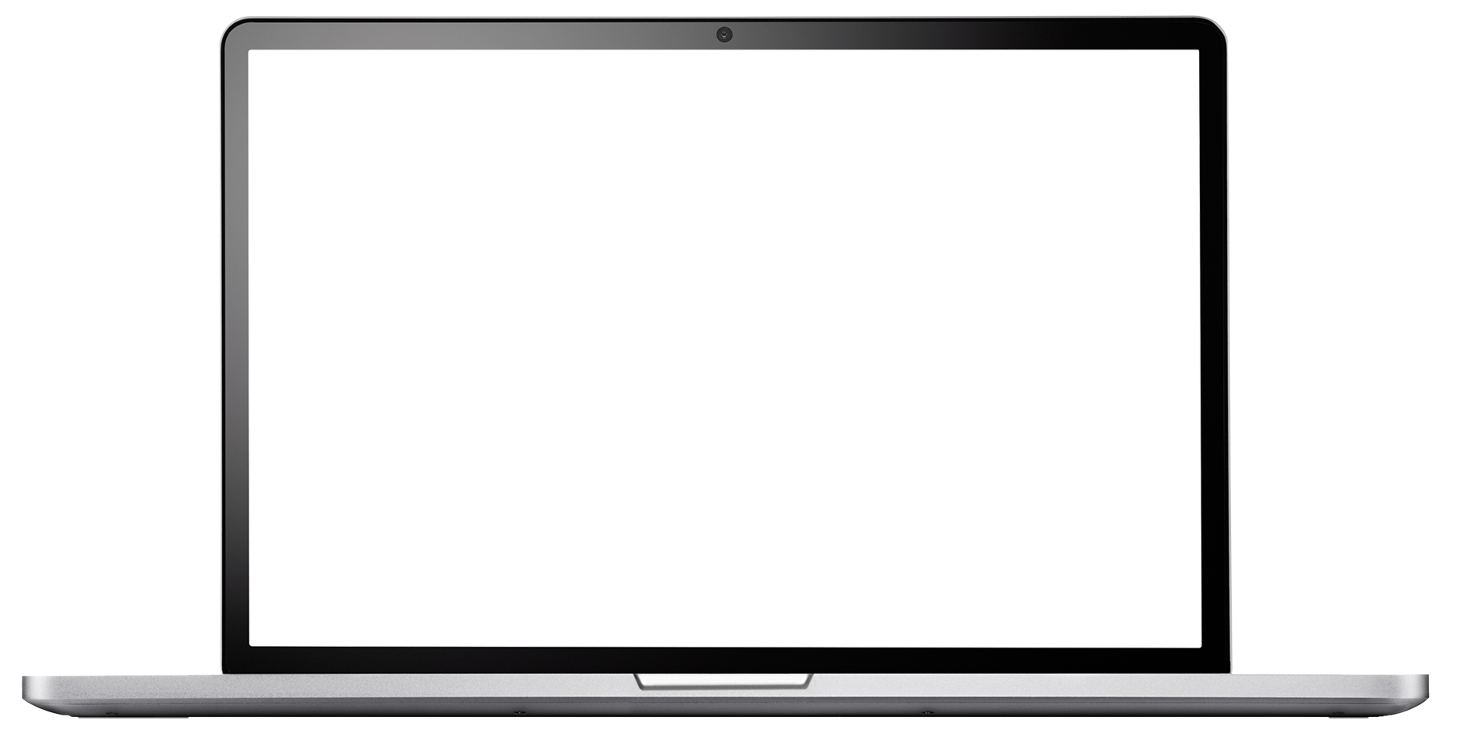
Sample website slide (blank)
Website screenshots can be placed behind this transparent .png

Slide 6
Bullet points layout with subtitle Subtitle is smaller in the same text block
Example of a bulleted slide with a subhead
Set the slide title to “Sentence case”
Set subheads to “Sentence case”
Hyperlink style
www.microsoft.com

